Slide 1


React Js

Slide 2
INDEX
React Components

Slide 3
React Components
React component is the building block of a React application.
A React component represents a small chunk of user interface in a webpage. The primary job of a React component is to render its user interface and update it whenever its internal state is changed. In addition to rendering the UI, it manages the events belongs to its user interface.
To summarize, React component provides below functionalities.
Initial rendering of the user interface.
Management and handling of events.
Updating the user interface whenever the internal state is changed.

Slide 4
React component accomplish these feature using three concepts −
Properties − Enables the component to receive input.
Events − Enable the component to manage DOM events and end-user interaction.
State − Enable the component to stay stateful. Stateful component updates its UI with respect to its state

Slide 5
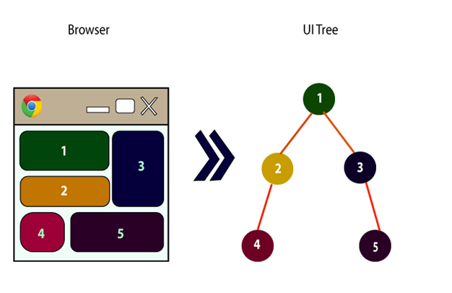
Every React component have their own structure, methods as well as APIs. They can be reusable as per your need. For better understanding, consider the entire UI as a tree. Here, the root is the starting component, and each of the other pieces becomes branches, which are further divided into sub-branches.

Slide 6
Creating a React component
React library has two component types. The types are categorized based on the way it is being created.
Function component − Uses plain JavaScript function.
class component − Uses class.
The core difference between function and class component are −
Function components are very minimal in nature. Its only requirement is to return a React element.
function Hello() {
return '<div>Hello</div>’
}

Slide 7
The same functionality can be done using ES6 class component with little extra coding.
class ExpenseEntryItem extends React.Component {
render() {
return (
<div>Hello</div>
);
}
}
In React, Render is the technique that can redirect a page with the help of function render(). Most importantly, render a function we can use to define the HTML code within the HTML element. It helps to display certain views in the UI using certain logic defined in the render function and returns the output.
Class components supports state management out of the box whereas function components does not support state management. But, React provides a hook, useState() for the function components to maintain its state.
Class component have a life cycle and access to each life cycle events through dedicated callback apis. Function component does not have life cycle. Again, React provides a hook, useEffect() for the function component to access different stages of the component.

Slide 8
Creating a class component
Class components have previously been the most commonly used among the four component types. This is because class components are able to do everything a functional component do but more. It can utilize the main functions of React, state, props, and lifecycle methods. Unlike functional components, class components are consist of … well, a class.

Slide 9
// Class Component Example
import React from 'react';
class HelloWorld extends React.Component {
render() {
return (
<div>
<p>Hello World!</p>
</div>
)
}
}
export default HelloWorld;

Slide 10
Class component syntax differs from functional component syntax. Class components use extends React.Component after declaring the class HelloWorld and requires a render() method to return JSX code. In this class component, you can declare a state, set it to a JavaScript object, and use props to be the initial state or change the state in lifecycle methods. Some lifecycle methods are componentDidMount(), componentDidUpdate(), and componentWillUnmount(). These are actions that a functional component cannot perform unless they use React Hooks.

Slide 11
Functional Components
Functional components are functions that takes in props and return JSX. They do not natively have state or lifecycle methods, but this functionality can be added by implementing React Hooks. Functional components are usually used to display information. They are easy to read, debug, and test.
// Functional Component Example
import React from 'react';
const HelloWorld = () => {
return (
<div>
<p>Hello World!</p>
</div>
)
}
export default HelloWorld;

Slide 12
In the code above, it is a very simple component that consists of a constant variable HelloWorld that is assigned to an arrow function which returns JSX. Functional components do not need to be arrow functions. They can be declared with regular JavaScript functions. You can also pass in props to the function and use them to render data in the JSX code.

Slide 13
Conclusion
A short summary of the components discussed:
Functional Components — functions that return JSX. Can do more stuff with React Hooks.
Class Components — classes that can manipulate state, props, and lifecycle methods.

Slide 14
Conclusion
A short summary of the components discussed:
Functional Components — functions that return JSX. Can do more stuff with React Hooks.
Class Components — classes that can manipulate state, props, and lifecycle methods.

Slide 15






EXAMPLES

Slide 16
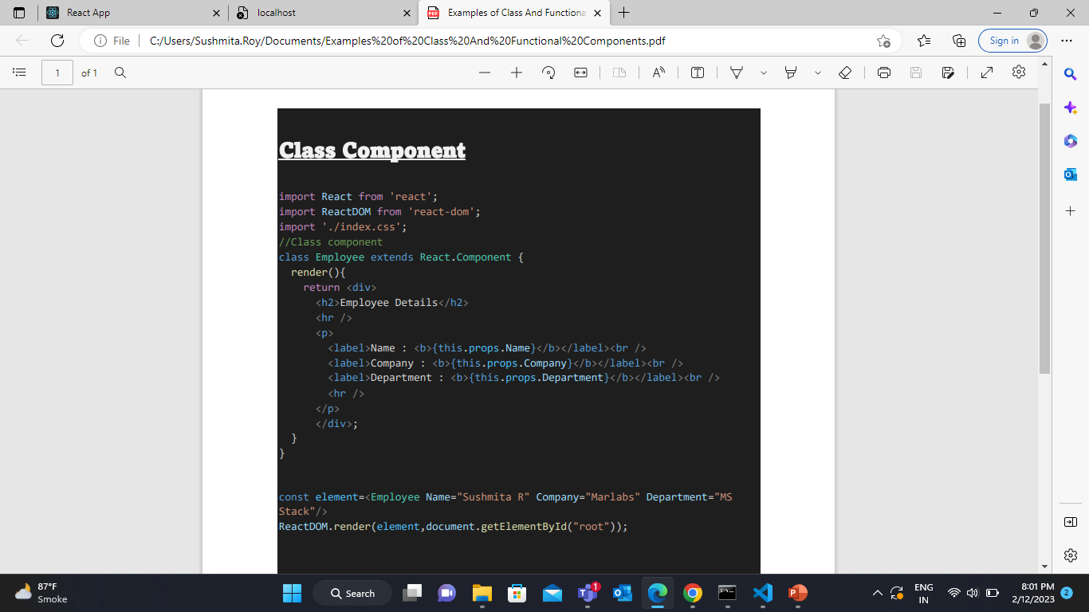

Slide 17
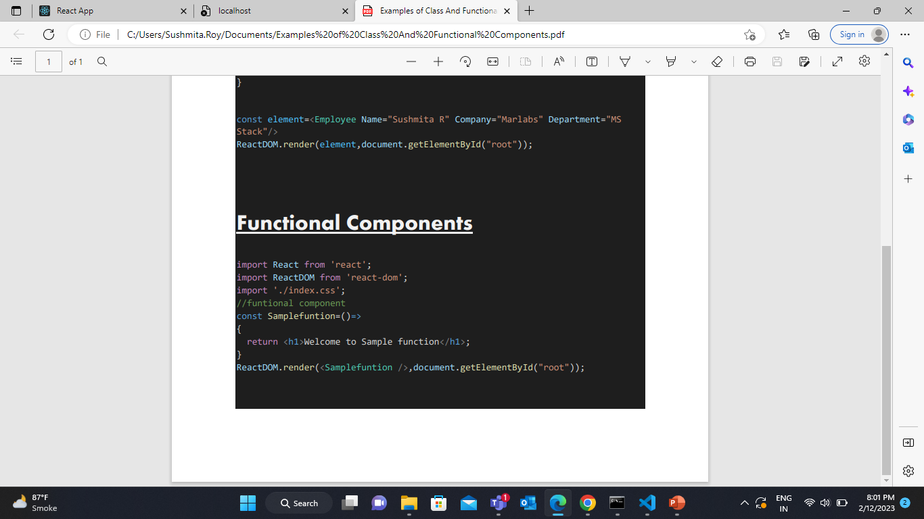

Slide 18
Thank You

